Slide 1
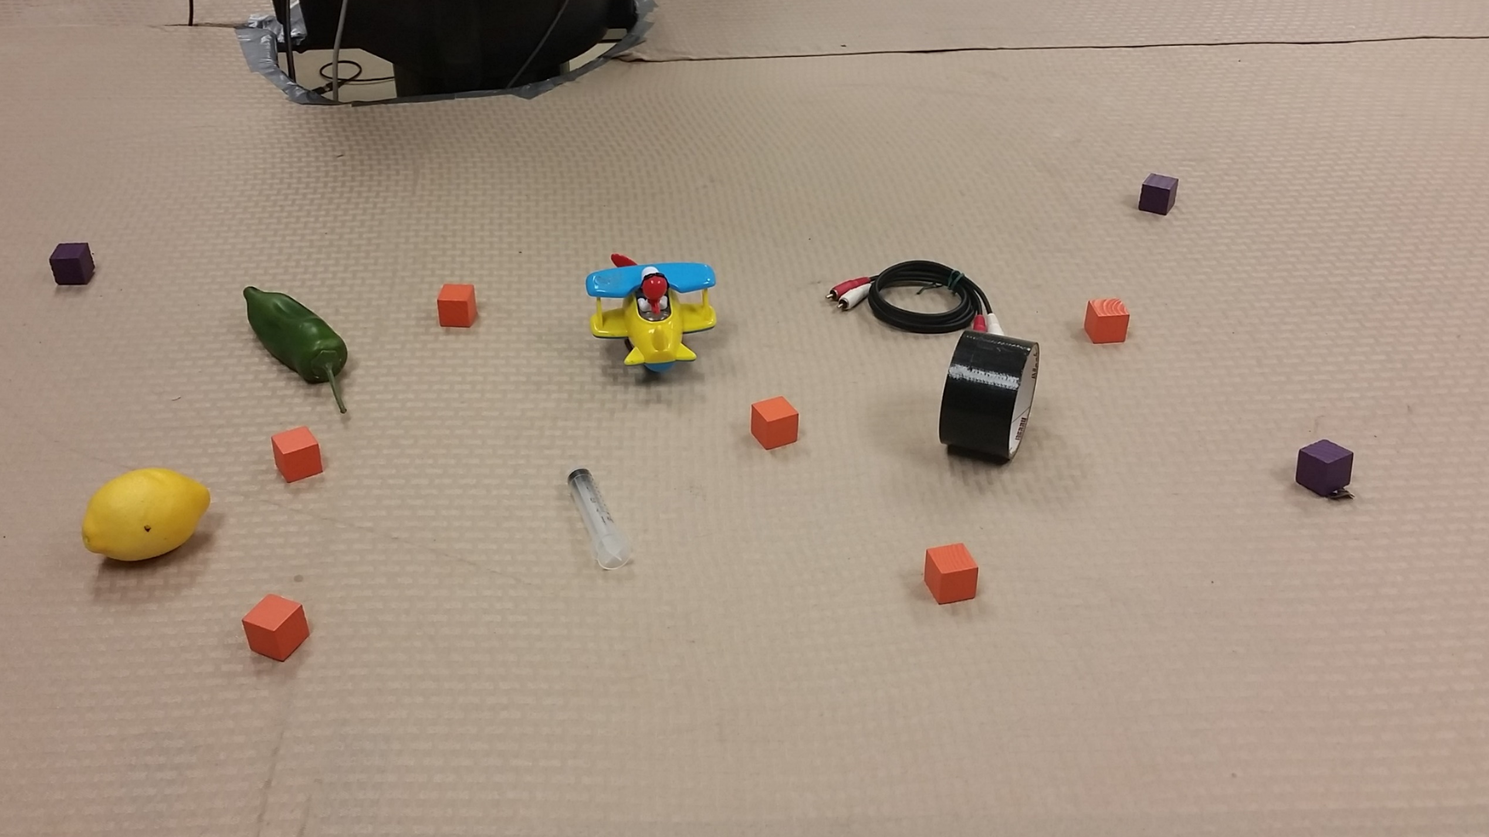
Incrementally Parsing Referring Expressions using Spatial Object Models
Gaurav Manek
Advisor: Prof. Stefanie Tellex
Reader: Prof. Eugene Charniak
Notes:
Incremental evaluation of example #368 from the test set.

Slide 2
3
6
4
1
5
2
“Orange cube between the toy and the tape roll”
Notes:
Incremental evaluation of example #368 from the test set.

Slide 3
The Problem
Referring expressions
with prepositions.
Incremental updates
update the distribution as each word is added.
The
…orange cube
…between the red
…and the yellow.

Slide 4
State-of-the-art
Citation
Tellex et al. 2011;
Matuszek et al. 2012;
Artzi and Zettlemoyer 2013;
Fang, Doering, and Chai 2015
Batch-mode
requires waiting for the complete utterance,
G3 system can take up to 30 seconds

Slide 5
3
6
4
1
5
2
“Orange cube between the toy and the tape roll”
Notes:
Incremental evaluation of example #368 from the test set.

Slide 6
3
6
4
1
5
2
“—

Slide 7
16%
16%
3
6
16%
16%
4
1
16%
16%
5
2
“Orange—

Slide 8
16%
16%
3
6
16%
16%
4
1
16%
16%
5
2
“Orange cube—

Slide 9
16%
15%
3
6
20%
17%
4
1
15%
14%
5
2
“Orange cube between—

Slide 10
16%
15%
3
6
20%
17%
4
1
15%
14%
5
2
“Orange cube between the—

Slide 11
20%
14%
3
6
23%
16%
4
1
13%
11%
5
2
“Orange cube between the toy—

Slide 12
20%
14%
3
6
23%
16%
4
1
13%
11%
5
2
“Orange cube between the toy and—

Slide 13
20%
14%
3
6
23%
16%
4
1
13%
11%
5
2
“Orange cube between the toy and the—

Slide 14
24%
14%
3
6
28%
9%
4
1
17%
5%
5
2
“Orange cube between the toy and the tape—

Slide 15
24%
14%
3
6
29%
8%
4
1
18%
4%
5
2
“Orange cube between the toy and the tape roll”

Slide 16
Technical Approach

Slide 17
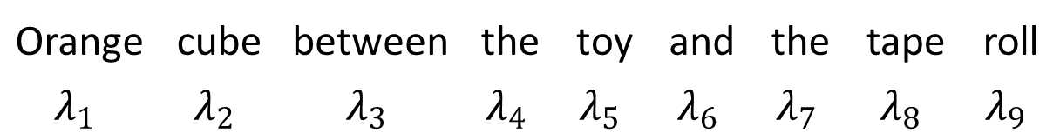
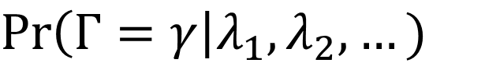
Distribution (over all objects)
that the input refers to.
Input words
$$\operatorname{Pr}\left(Γ=γ\right|λ_{1},λ_{2},…)$$
Target object
Orange | cube | between | the | toy | and | the | tape | roll
$$λ_{1}$$ | $$λ_{2}$$ | $$λ_{3}$$ | $$λ_{4}$$ | $$λ_{5}$$ | $$λ_{6}$$ | $$λ_{7}$$ | $$λ_{8}$$ | $$λ_{9}$$

Slide 18
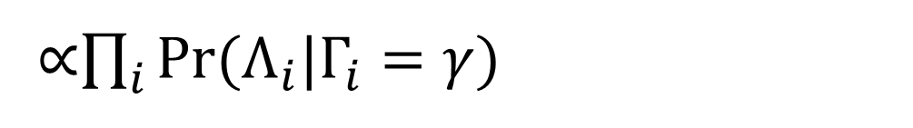
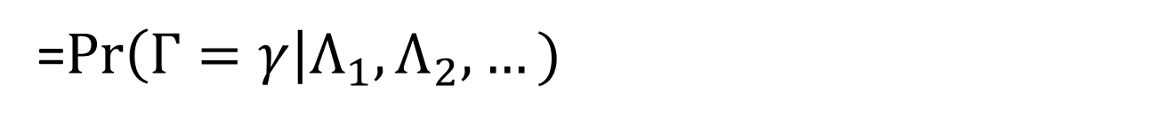
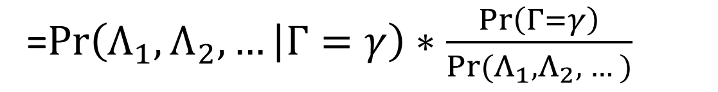
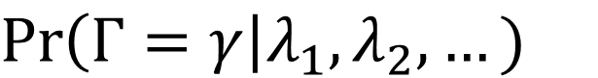
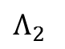
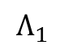
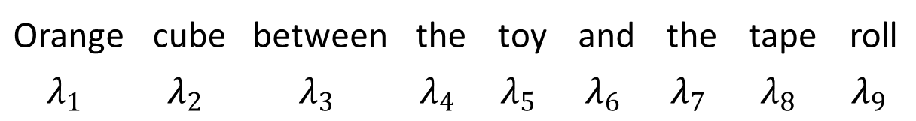
$$\operatorname{Pr}\left(Γ=γ\right|λ_{1},λ_{2},…)$$
=$\operatorname{Pr}\left(Γ=γ\right|Λ_{1},Λ_{2},…)$
=$\operatorname{Pr}\left(Λ_{1},Λ_{2},… | Γ=γ\right)∗\frac{\operatorname{Pr}\left(Γ=γ\right)}{Pr⁡(Λ_{1},Λ_{2}, …)}$
∝$\prod_{i}^{ }{Pr(Λ_{i}|Γ_{i}=γ)}{ }$
Orange | cube | between | the | toy | and | the | tape | roll
$$λ_{1}$$ | $$λ_{2}$$ | $$λ_{3}$$ | $$λ_{4}$$ | $$λ_{5}$$ | $$λ_{6}$$ | $$λ_{7}$$ | $$λ_{8}$$ | $$λ_{9}$$
$$Λ_{1}$$
$$Λ_{2}$$

Slide 19
Orange | cube | between | the | toy | and | the | tape | roll
$$Λ_{1}$$
$$Λ_{2}$$

Slide 20
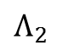
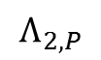
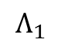
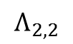
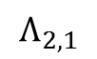
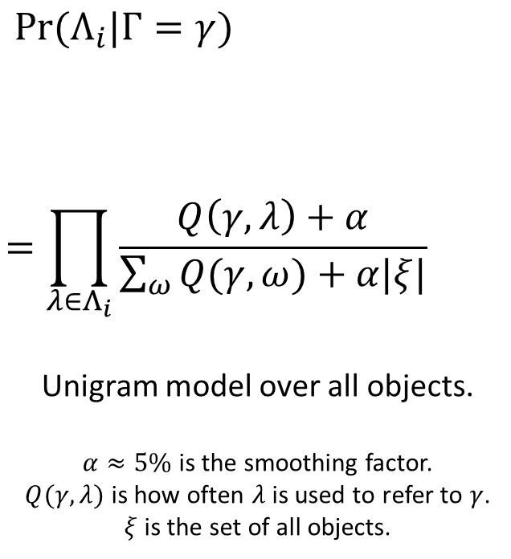
Orange | cube | between | the | toy | and | the | tape | roll
$$Λ_{1}$$
$$Λ_{2}$$
$$Λ_{2,P}$$
$$Λ_{2,1}$$
$$Λ_{2,2}$$
$$\operatorname{Pr}{(Λ_{i}|Γ=γ) }$$
$$=\prod_{λ∈Λ_{i}}{\frac{Q\left(γ,λ\right)+α}{\sum_{ω}{Q(γ,ω)}+α|ξ|}}$$
Unigram model over all objects.
$α≈5\%$ is the smoothing factor.
$Q(γ,λ)$ is how often $λ$ is used to refer to $γ$.
$ξ$ is the set of all objects.

Slide 21
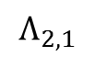
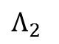
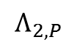
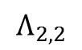
Orange | cube | between | the | toy | and | the | tape | roll
$$Λ_{2}$$
$$Λ_{2,P}$$
$$Λ_{2,1}$$
$$Λ_{2,2}$$

Slide 22
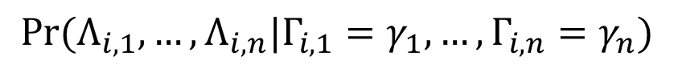
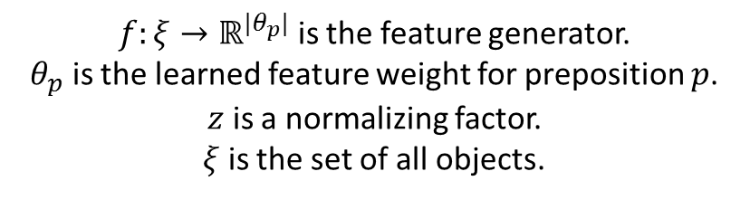
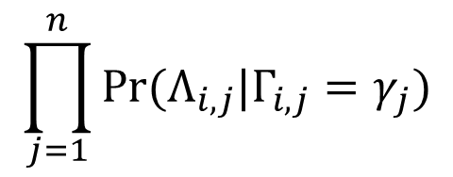
Orange | cube | between | the | toy | and | the | tape | roll
$$Λ_{2}$$
$$Λ_{2,P}$$
$$Λ_{2,1}$$
$$Λ_{2,2}$$
$$\operatorname{Pr}{(Λ_{i}|Γ=γ)={\operatorname{Pr}{(Λ_{i,P},Λ_{i,1},…,Λ_{i,n}| Γ =γ)}} }$$
$$∝{\sum_{γ_{1}∈ξ}{⋯\sum_{γ_{n}∈ξ}{\operatorname{Pr}{(Λ_{i,P}, Γ_{i,1}=γ_{1}, …,Γ_{i,n}=γ_{n}| Γ =γ)}⋅}}}$$
$$\operatorname{Pr}{(Λ_{i,1},…,Λ_{i,n}|Γ_{i,1}=γ_{1}, …,Γ_{i,n}=γ_{n})}$$
$$\prod_{j=1}^{n}{\operatorname{Pr}{(Λ_{i,j}|Γ_{i,j}=γ_{j})}}$$
$$={\sum_{γ_{1}∈ξ}{⋯\sum_{γ_{n}∈ξ}{S\left(\frac{f\left(γ, γ_{1},{…,γ}_{n} \right)⋅θ_{p}}{z}\right)⋅}}}$$
Preposition Model
Groundings
$f:ξ→ℝ^{|θ_{p}|}$ is the feature generator.
$θ_{p}$ is the learned feature weight for preposition $p$.
$z$ is a normalizing factor.
$ξ$ is the set of all objects.

Slide 23
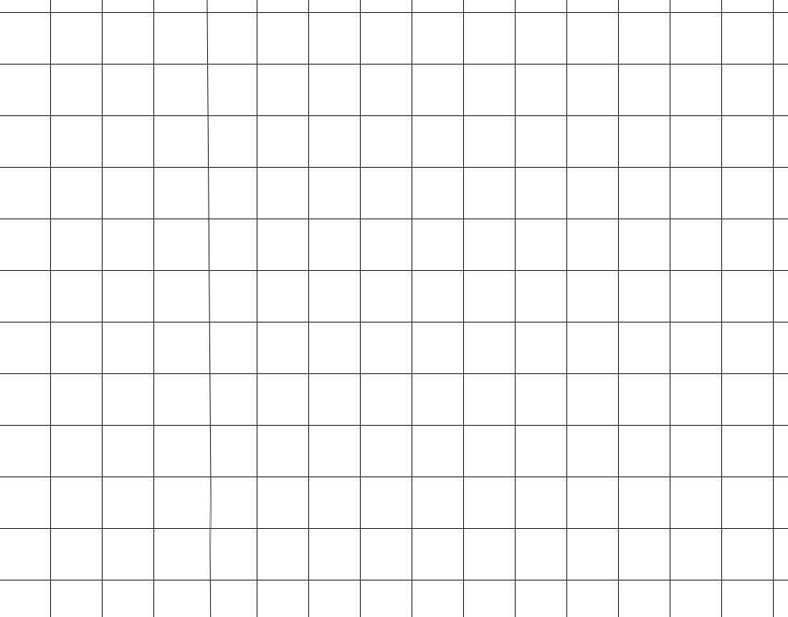
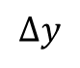
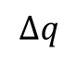

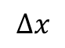

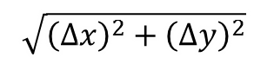


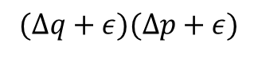



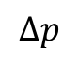
Features
f$\left(γ, γ_{1}\right)$
{near, left, right, in front of, behind}
f$\left(γ,γ_{1},γ_{2}\right)$
{between}
$$γ$$
$$(Δq+ε)(Δp+ε)$$
$$γ$$
$$\sqrt{{\left(Δx\right)}^{2}+{\left(Δy\right)}^{2}}$$
$$Δq$$
$$Δy$$
$$γ_{2}$$
$$γ_{1}$$
$$Δx$$
$$Δp$$
$$γ_{1}$$

Slide 24
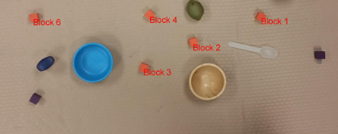
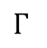
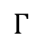
Implementation
Back to Cache
Output
$$Γ$$
the toy
Unigram Evaluation
+ Prepositional Phrase Evaluation
the tape
Orange cube
between
Orange cube
Tree Reconstruction
$$Γ$$
the toy
between
the tape
CRF Tagging
Orange | cube | between | the | toy | and | the | tape
SNP | SNP | PRP | SNP | SNP | PRP | SNP | SNP
Cache
Scene
Sentence
Next Word

Slide 25
Tree Structure
How our factorization allows for efficient incremental parsing.

Slide 26
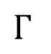
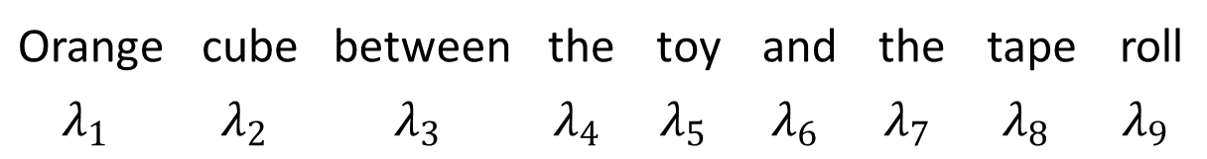
Tree Structure
$$Γ$$
between
Orange | cube |  | the | toy |  | the | tape | roll
Orange | cube | between | the | toy | and | the | tape | roll
$$λ_{1}$$ | $$λ_{2}$$ | $$λ_{3}$$ | $$λ_{4}$$ | $$λ_{5}$$ | $$λ_{6}$$ | $$λ_{7}$$ | $$λ_{8}$$ | $$λ_{9}$$

Slide 27
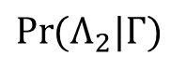

Tree Structure – Step 1
$$Γ$$
$$\operatorname{Pr}{(Λ_{2}|Γ)}$$
Use the preposition model to generate a distribution using prepositions.
Use the unigram language model to convert each grounding to a distribution
$$\operatorname{Pr}{(Λ_{1}|Γ) }$$ |  | $$\operatorname{Pr}{(Λ_{2,1}|Γ)}$$ |  | $$\operatorname{Pr}{(Λ_{2,2}|Γ) }$$
Orange | cube | between | the | toy | and | the | tape | roll
$$λ_{1}$$ | $$λ_{2}$$ | $$λ_{3}$$ | $$λ_{4}$$ | $$λ_{5}$$ | $$λ_{6}$$ | $$λ_{7}$$ | $$λ_{8}$$ | $$λ_{9}$$

Slide 28
Tree Structure – Step 2
$$Γ$$
$$\operatorname{Pr}{(Λ_{2}|Γ)}$$
Use the preposition model to generate a distribution using prepositions.
Use the unigram language model to convert each grounding to a distribution
$$\operatorname{Pr}{(Λ_{1}|Γ) }$$ |  | $$\operatorname{Pr}{(Λ_{2,1}|Γ)}$$ |  | $$\operatorname{Pr}{(Λ_{2,2}|Γ) }$$
Orange | cube | between | the | toy | and | the | tape | roll
$$λ_{1}$$ | $$λ_{2}$$ | $$λ_{3}$$ | $$λ_{4}$$ | $$λ_{5}$$ | $$λ_{6}$$ | $$λ_{7}$$ | $$λ_{8}$$ | $$λ_{9}$$

Slide 29
Tree Structure – Step 3
$$Γ$$
$$\operatorname{Pr}{(Λ_{2}|Γ)}$$
Use the preposition model to generate a distribution using prepositions.
Use the unigram language model to convert each grounding to a distribution
$$\operatorname{Pr}{(Λ_{1}|Γ) }$$ |  | $$\operatorname{Pr}{(Λ_{2,1}|Γ)}$$ |  | $$\operatorname{Pr}{(Λ_{2,2}|Γ) }$$
Orange | cube | between | the | toy | and | the | tape | roll
$$λ_{1}$$ | $$λ_{2}$$ | $$λ_{3}$$ | $$λ_{4}$$ | $$λ_{5}$$ | $$λ_{6}$$ | $$λ_{7}$$ | $$λ_{8}$$ | $$λ_{9}$$

Slide 30
Incremental Parsing
How our factorization allows for efficient incremental parsing.

Slide 31
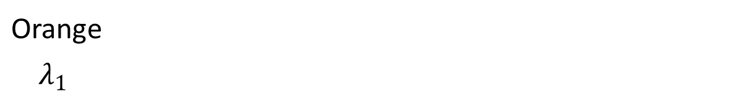
Incremental Parsing
$$Γ$$
Recomputed
this step
$$\operatorname{Pr}{(Λ_{1}|Γ) }$$
Orange
$$λ_{1}$$

Slide 32
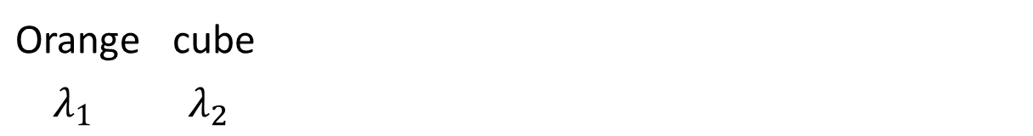
Incremental Parsing
$$Γ$$
Recomputed
this step
$$\operatorname{Pr}{(Λ_{1}|Γ) }$$
Orange | cube
$$λ_{1}$$ | $$λ_{2}$$

Slide 33
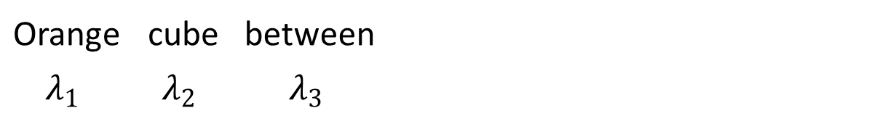
Incremental Parsing
$$Γ$$
Recomputed
this step
$$\operatorname{Pr}{(Λ_{2}|Γ)}$$
$$\operatorname{Pr}{(Λ_{1}|Γ) }$$
Orange | cube | between
$$λ_{1}$$ | $$λ_{2}$$ | $$λ_{3}$$

Slide 34
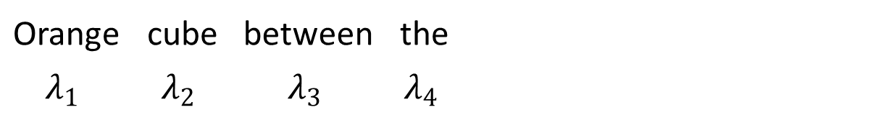
Incremental Parsing
$$Γ$$
Recomputed
this step
$$\operatorname{Pr}{(Λ_{2}|Γ)}$$
$$\operatorname{Pr}{(Λ_{1}|Γ) }$$ |  | $$\operatorname{Pr}{(Λ_{2,1}|Γ)}$$
Orange | cube | between | the
$$λ_{1}$$ | $$λ_{2}$$ | $$λ_{3}$$ | $$λ_{4}$$

Slide 35
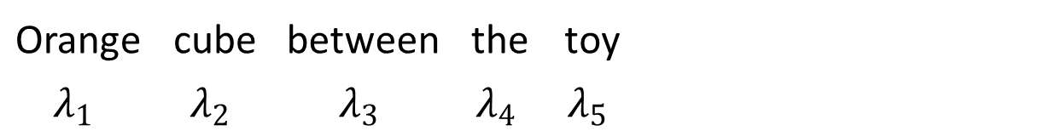
Incremental Parsing
$$Γ$$
Recomputed
this step
$$\operatorname{Pr}{(Λ_{2}|Γ)}$$
$$\operatorname{Pr}{(Λ_{1}|Γ) }$$ |  | $$\operatorname{Pr}{(Λ_{2,1}|Γ)}$$
Orange | cube | between | the | toy
$$λ_{1}$$ | $$λ_{2}$$ | $$λ_{3}$$ | $$λ_{4}$$ | $$λ_{5}$$

Slide 36
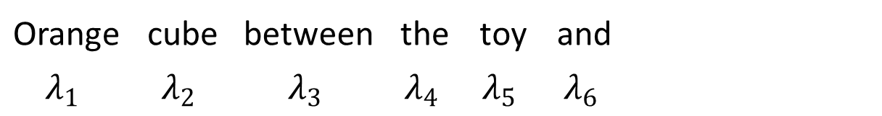
Incremental Parsing
$$Γ$$
Recomputed
this step
$$\operatorname{Pr}{(Λ_{2}|Γ)}$$
$$\operatorname{Pr}{(Λ_{1}|Γ) }$$ |  | $$\operatorname{Pr}{(Λ_{2,1}|Γ)}$$
Orange | cube | between | the | toy | and
$$λ_{1}$$ | $$λ_{2}$$ | $$λ_{3}$$ | $$λ_{4}$$ | $$λ_{5}$$ | $$λ_{6}$$

Slide 37
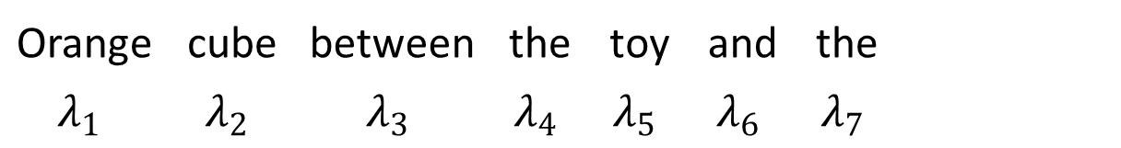
Incremental Parsing
$$Γ$$
Recomputed
this step
$$\operatorname{Pr}{(Λ_{2}|Γ)}$$
$$\operatorname{Pr}{(Λ_{1}|Γ) }$$ |  | $$\operatorname{Pr}{(Λ_{2,1}|Γ)}$$ |  | $$\operatorname{Pr}{(Λ_{2,2}|Γ) }$$
Orange | cube | between | the | toy | and | the
$$λ_{1}$$ | $$λ_{2}$$ | $$λ_{3}$$ | $$λ_{4}$$ | $$λ_{5}$$ | $$λ_{6}$$ | $$λ_{7}$$

Slide 38
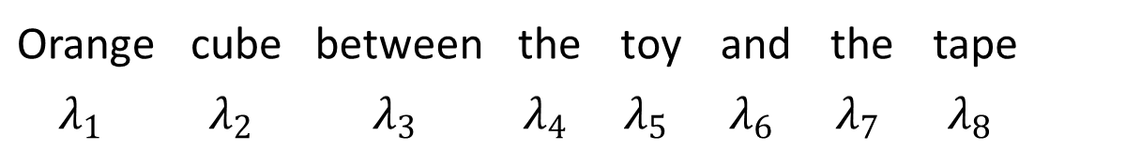
Incremental Parsing
$$Γ$$
Recomputed
this step
$$\operatorname{Pr}{(Λ_{2}|Γ)}$$
$$\operatorname{Pr}{(Λ_{1}|Γ) }$$ |  | $$\operatorname{Pr}{(Λ_{2,1}|Γ)}$$ |  | $$\operatorname{Pr}{(Λ_{2,2}|Γ) }$$
Orange | cube | between | the | toy | and | the | tape
$$λ_{1}$$ | $$λ_{2}$$ | $$λ_{3}$$ | $$λ_{4}$$ | $$λ_{5}$$ | $$λ_{6}$$ | $$λ_{7}$$ | $$λ_{8}$$

Slide 39
Incremental Parsing
$$Γ$$
Recomputed
this step
$$\operatorname{Pr}{(Λ_{2}|Γ)}$$
$$\operatorname{Pr}{(Λ_{1}|Γ) }$$ |  | $$\operatorname{Pr}{(Λ_{2,1}|Γ)}$$ |  | $$\operatorname{Pr}{(Λ_{2,2}|Γ) }$$
Orange | cube | between | the | toy | and | the | tape | roll
$$λ_{1}$$ | $$λ_{2}$$ | $$λ_{3}$$ | $$λ_{4}$$ | $$λ_{5}$$ | $$λ_{6}$$ | $$λ_{7}$$ | $$λ_{8}$$ | $$λ_{9}$$

Slide 40
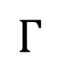
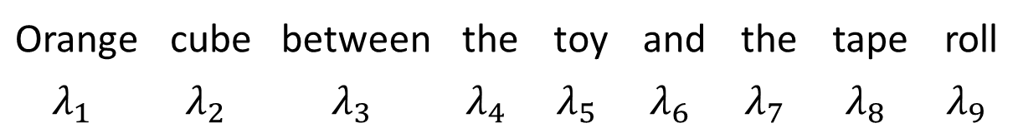
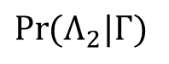
Incremental Parsing
$$Γ$$
Recomputed
this step
Maximum depth of 3, which limits the work done per step.
$$\operatorname{Pr}{(Λ_{2}|Γ)}$$
$$\operatorname{Pr}{(Λ_{1}|Γ) }$$ |  | $$\operatorname{Pr}{(Λ_{2,1}|Γ)}$$ |  | $$\operatorname{Pr}{(Λ_{2,2}|Γ) }$$
Orange | cube | between | the | toy | and | the | tape | roll
$$λ_{1}$$ | $$λ_{2}$$ | $$λ_{3}$$ | $$λ_{4}$$ | $$λ_{5}$$ | $$λ_{6}$$ | $$λ_{7}$$ | $$λ_{8}$$ | $$λ_{9}$$

Slide 41
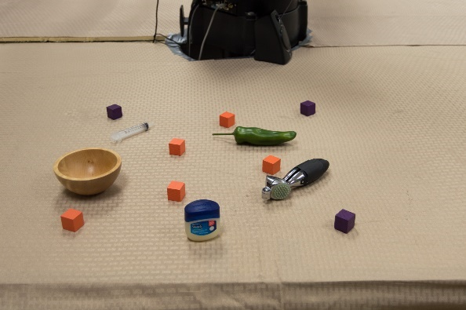
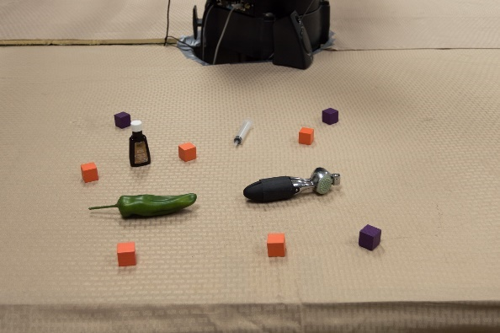
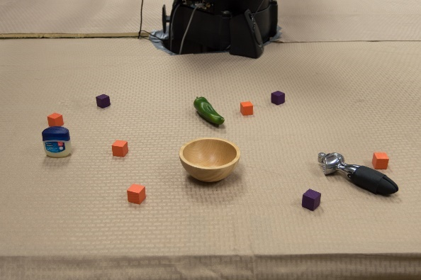
















Turk Tasks

Slide 42


Slide 43


Slide 44

Incremental parsing is fast: 3-5 words per second.

Slide 45

Failure Analysis: Incorrect & Imprecise Data
We test the correctness of our model on subsets of the test set.
r is the number of human raters that have correctly identified the target.

Slide 46

Future Work
Implement it on Baxter
Pick-and-place task
Perform a user-study to see if it improves interaction (compared to batch-mode.)
Social feedback
Integrate it with Emily Wu’s social feedback framework.

Slide 47
Contributions
Referring Expression parsing
Model for incremental parsing
Implementation
Fast enough to keep up with speech
Real-world data
Used to characterized accuracy and performance

